Slide 1
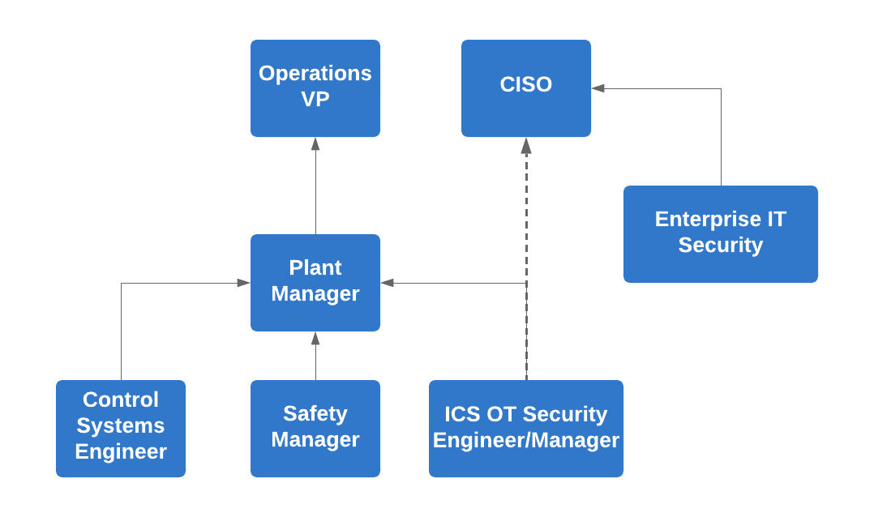
Example Matrixed Governance – Oil & Gas CISO implemented

Slide 2
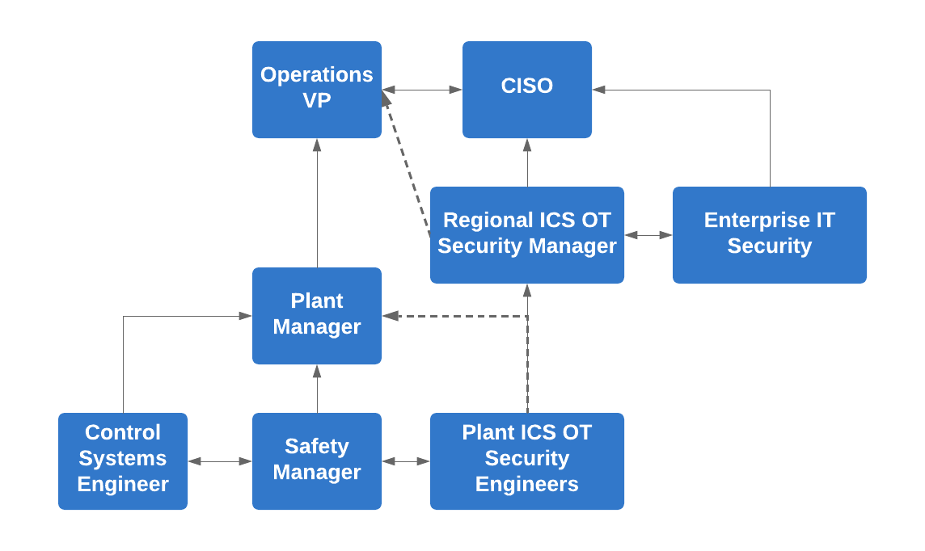
Example Matrixed Governance – To Be option

Slide 3
ICS OT Security Executive Level Committee Members
CISO
CSO
CTO/VP of Technology
Busines Owner/VP (e.g. VP of Pulp, VP of Solid Wood, VP of Safety etc)
Large Mill Regional Managers
Selected Mill level Managers (at least one from each business vertical (e.g. solid wood vs pulp) and region (US and Canada) for representation)

Slide 4
ICS OT Security Technical Level Committee Members
Plant level Safety Manager/Engineers
Regional ICS OT Security Manager
Plant level lead ICS OT Security SME/Engineer
CISO
Lead IT Security Support SME
Lead Control Systems Engineers (Regional, Business Area, and Plant)
Quality Engineers
Plant level Production Engineer Leads

